Slide 1
Taiwan Tea Corporation
2019 Investor Conference

Slide 2
Disclaimer
In these presentations and discussions, there are certain forward looking statements regarding the results of operation, financial condition and current expectation abort future events. As forward-looking statements relate to events and depend on circumstances in the future, they involve risk and uncertainty.
We do not undertake any obligation to publicly revise or update any forward looking statements for availability of new information, future events or otherwise. Real result probably differ substantially from those expected in these forward-looking statements.

Slide 3
Agenda
Company Profile
Review of perations
Business Highlight
Business Outlook
Q&A

Slide 4
Company Profile
Date of Establishment ：1950.6.15
Listed on TWSE：1962.2
Paid-in capital stock : NT $7.9 billion
Chairman：Ching-Yuan Wu
General manage ：Chin-Yen Lin
Agriculture & Tea business
Recreational Business
Land Development
Nursery and cultivate of agricultural and tea products to produce a commodity for commercial and retail business.
Consolidate the agricultural business with the use of land assets to develop distinctive recreation and tourism markets.
Devising and implementation of the land assets for inventory management and vitalize integrated development feasibility.

Slide 5

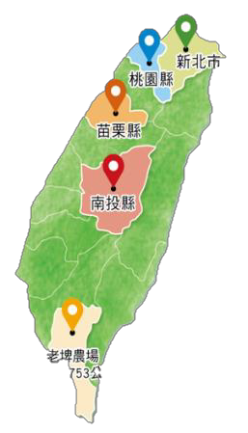









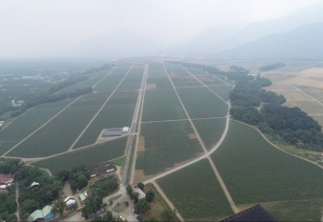
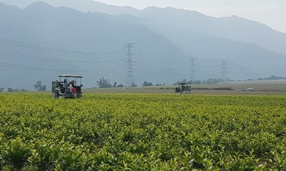
Company Profile-Tea garden/factory distribution
復興茶廠、大溪老茶廠
熊空茶廠、大寮茶文館
DAXI TEA FACTORY
XIONGKONG TEA GARDEN
Area: 3.4 ha
Cultivars : Green tea & black tea
Area: 5.4ha
Cultivars : Organic Green Tea, black tea and Oolong Tea
三義茶廠、銅鑼茶廠
魚池茶廠、日月老茶廠
SANYI、TONGLUO TEA FACTORY
ANTIQUE ASSAM TEA FARM
Area: 16 ha
Cultivars : Oriental Beauty Tea
Area:20.2 ha
Cultivars : TTES No. 8、No. 18、No. 21
精製廠、老埤農場
Laupi Tea Farm
鹿篙咖啡莊園
Area:717 ha
(Tea Garden Approx. 470ha)
Cultivars: TTES No. 8,No. 2,No. 17,No. 18, Chin-Shin Da Pan and Shi-Ji-Chun (Four Season)
LUGAO COFFEE GARDEN
Coffee Garden field: 12.7 ha
Local specialty : Sun Moon Lake Coffee

Slide 6
Review of perations -Individual statements of comprehensive income

Slide 7
Review of perations - Individual balance sheets

Slide 8
Business Highlight- Tea Business
Laupi Tea Farm Progress
20%
87%
Operating Machines
Tea Plantation
99%
10%
Factory Building
Storage
On 2019-12-6

Slide 9
Business Highlight- Tea Business
TTC Tea Service Management Operation (Under Construction)
Farm Management System
Customer Service System
Tea process system
TTC Information Cloud
Tea Flavor Evaluation System

Slide 10
Business Highlight- Tea Business
Overcome problem to generate stable revenue
Food Safty?
科技
Technology
Transparent of Origin?
生態
Ecology
Stable flavor?
食安
Food Safety
Technical Heritage?

Slide 11
Business Highlight- Recreational Business
DAXI TEA FACTORY
Area:3.7 ha
TONGLUO TEA FACTORY
Area:30 ha
XIONGKONGTEA GARDEN Area:165 ha (Tea garden Approx 5.6 ha
DALIAO HISTORICAL HOUSE
Area:3 ha
ANTIQUE ASSAM TEA FARM
Area:21 ha
LUGAO COFFEE GARDEN
Area:5 ha (Tea garden Approx 2.5 ha

Slide 12
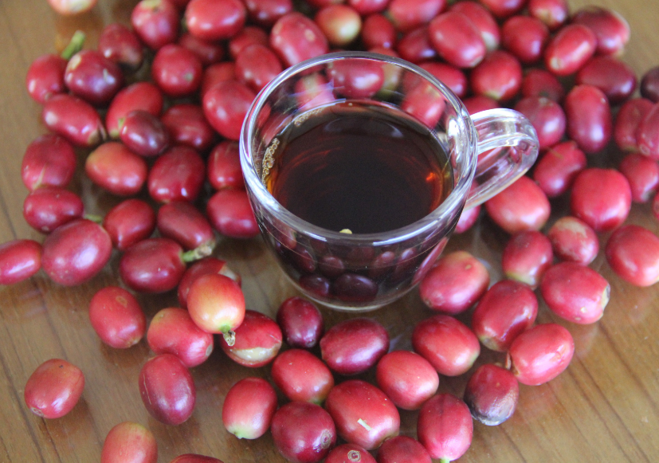
Business Highlight- LUGAO COFFEE GARDEN
Main Operations
手感一顆豆到一杯咖啡
Farm to Cup
Coffee Garden
Visit/Tour
Coffee Tree
Coffee Factory
Explain
The Processing of Coffee beans
Sales
Pour over coffee
Pleasure
Interest
Roasting
Operating Machines
Roasting Coffee Beans
Coffee DIY
Practice
Grinding / Pour

Slide 13
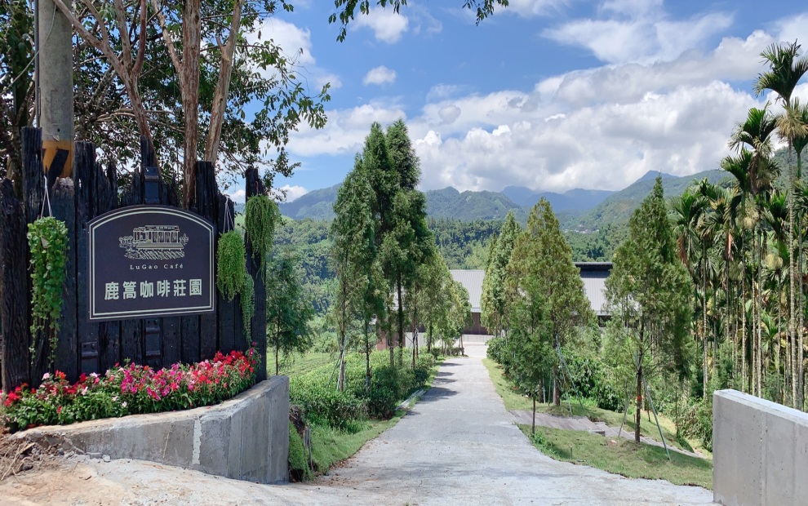
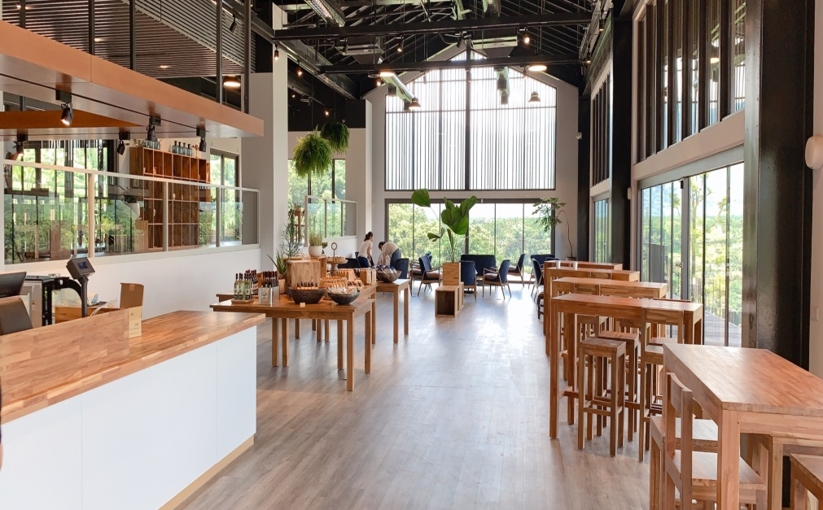
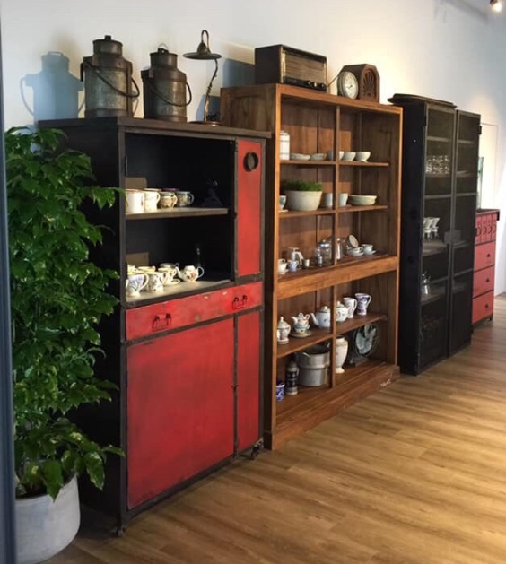
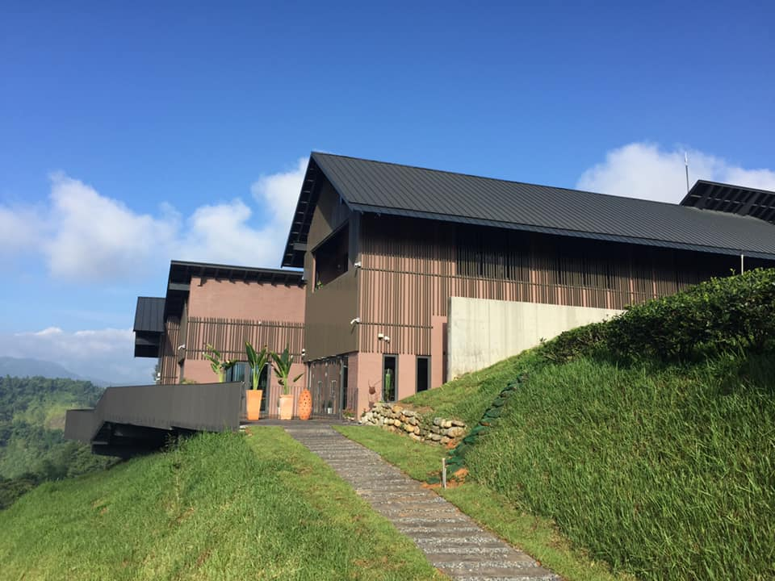
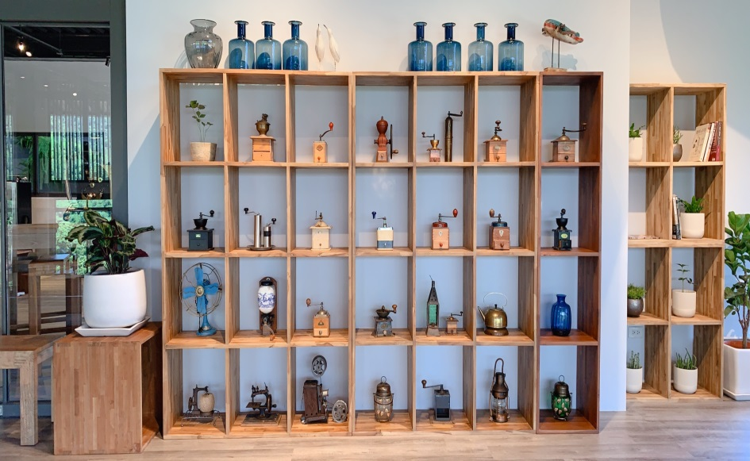
Business Highlight- LUGAO COFFEE GARDEN
台灣第一座訪客透過咖啡園導覽,近距離眼見親觸咖啡樹,並參觀咖啡製程的咖啡莊園.
訪客可參與咖啡實習教學,自主研磨咖啡,沖泡,實際領略一顆豆到一杯咖啡的手感

Slide 14
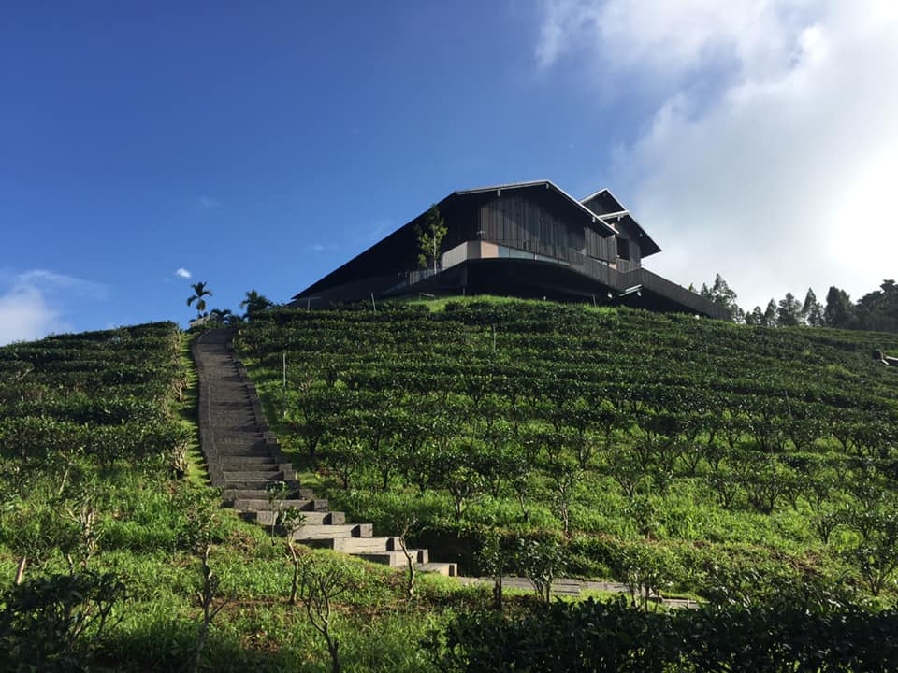
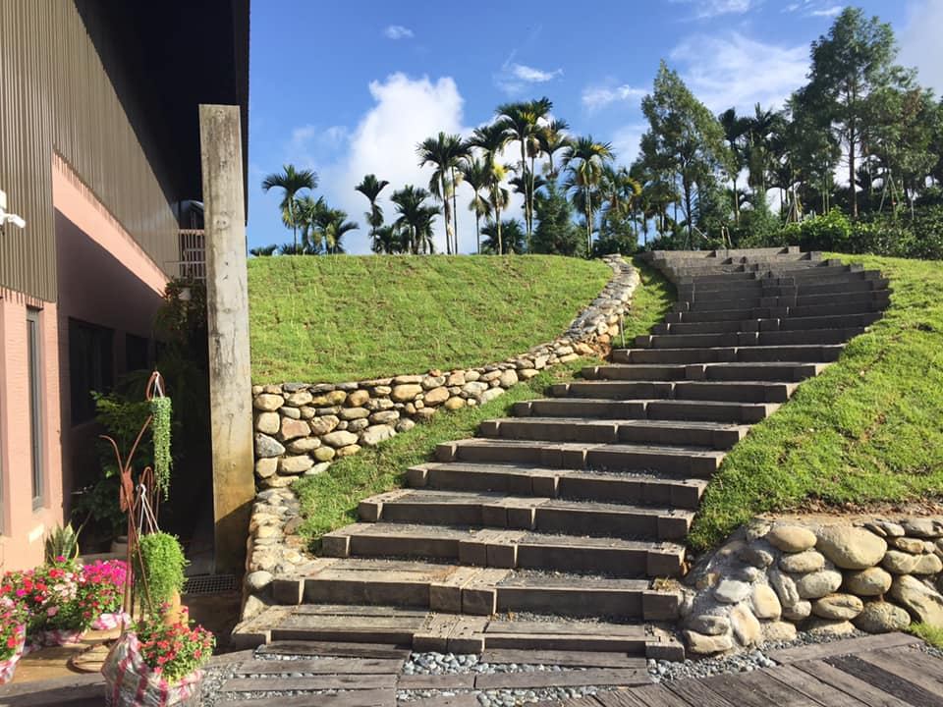
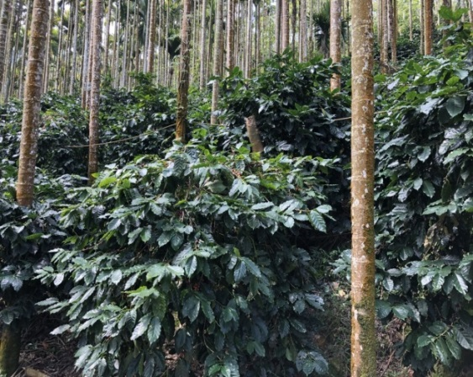
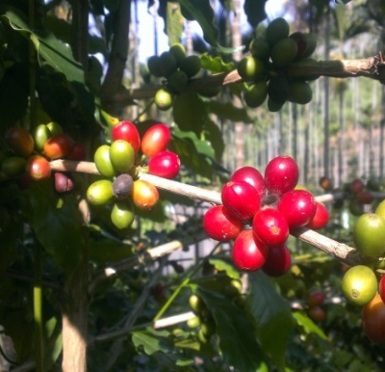
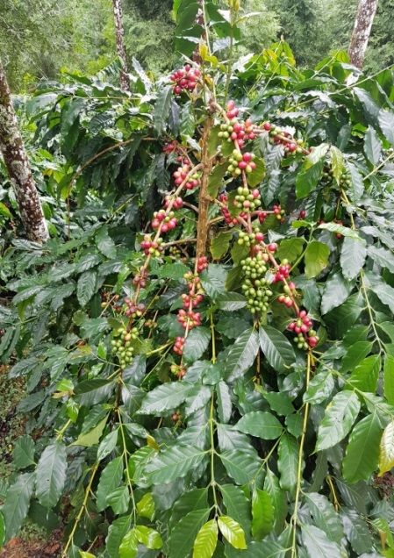
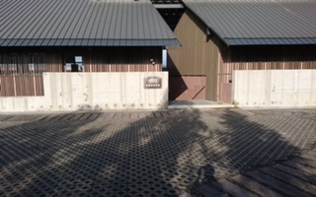
Business Highlight- LUGAO COFFEE GARDEN
生產咖啡並可教學實習的複合據點.
咖啡多為自然草生栽種,人工採摘,品質純淨. 蓄含花柚杏桃等蜜甜花果香. 口感溫順 微酸. 2017獲日月潭精品咖啡評鑑頭獎.年2019年7月底完成試營運.

Slide 15








Land Development 【Large land development cases】
Commercial Park
TTC Sanyi Industrial/Commercial Park
  •In 2008 , acquired land development permission
  •In 2010 , completed water conservation and land preparation
  •In 2010 , completed revising land functional zone
Residential Project
Miaoli Tongluo Residential Project
    •In 2014, acquired land development permission
  •In 2019 , completed water conservation and land preparation •In 2019 , completed revising land functional zone
Commercial Park/
Exhibition Hall/Hotel
Miaoli Tongluo Industrial/Commercial Park
    •In 2014, acquired land development permission
    •In 2019, completed water conservation and land preparation
  •In 2019 , completed revising land functional zone
Land development
increase asset value
Recreational Park
Sun Moon Lake Recreational Project
    •In 2015 , acquired land development permission
    •In 2018, water conservation and land preparation
    plan permitted
    •Connecting road required
Land asset vitalization is our main goal from 2007
Developed large land cases step into constructing phases
Select potential land to develop in 2020
Development Projects
of Next Year
Profession consulting
Potential cases selection
Financial investment

Slide 16
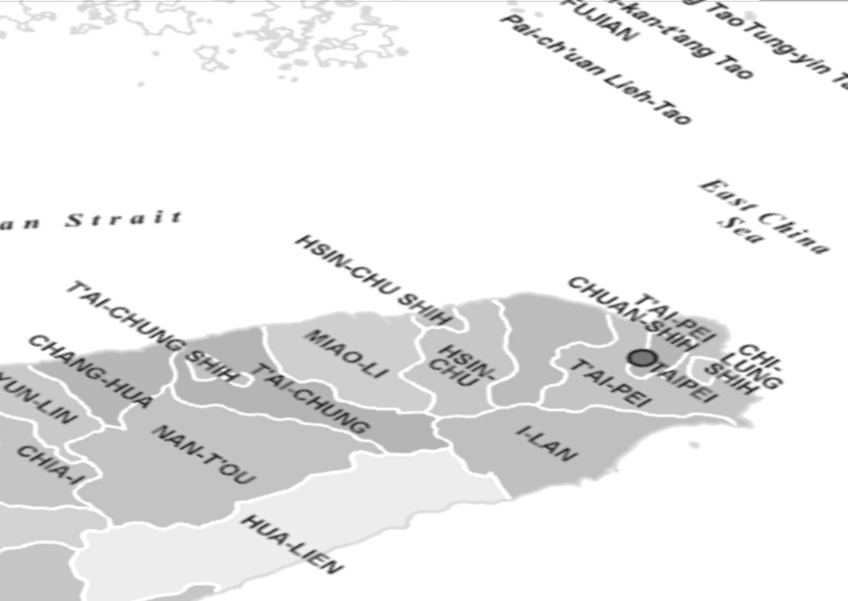



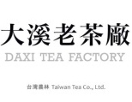
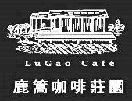

Land Development 【Leisure business bases】
Miaoli Tongluo tea factory
  • Operating from 2013
Miaoli Tongluo recreational farm
  • In 2017, development permission approved
  • In 2019, building license altered
  • In 2020, operation approval will be acquired
Shimen forest recreational farm
  •In 2018, farm operating approved
Xion Kong tea farm
  •Operating from 2007
Xion Kong tea recreation farm
  • In 2016, development permission approved
  • In 2018, water conservation and land
  preparation completed
  • In 2020, operation approval will be acquired
Nantou Lu Gou coffee farm
  •Operating from 2019
Nantou Lu Gou coffee recreational farm
  •Preparing and planning from 2019
石門休閒農場
Leisure business bases
Eco-friendly environment
Self-operating tea farms linked
Taoyuan Daxi tea factory
  •In 2010, building repaired
Taoyuan Daxi recreational farm
  • In 2018, development permission approved
  • In 2019, water conservation plan approved
• Building are designed

Slide 17
展望未來
Increase asset value
  Vitalize land development activation by generating more self-use、 lease or cooperation to enhance a profitable space.
  Interact with the govertment land development program to implement feasible planning solutions for land integration and reuse for the long-term potential value-added assets.
Reaching Performance goal
Strengthen technical capabilities
  Promoting the industrialization of the large-scale tea production system to Laupi Tea Farm and create an innovative tea-making industry chain respond to the robust demand for domestic beverage tea.
  Providing tea products with more safety, stable quality & quantities and price to expand the commercial tea market.
  The intensify implementation of the technological capabilities to scientific and technological farms to standardize the efficiency of modern tea factories and establish soft power that can replicate the large-scale economic model of the tea business.

Slide 18
Q & A

Slide 19
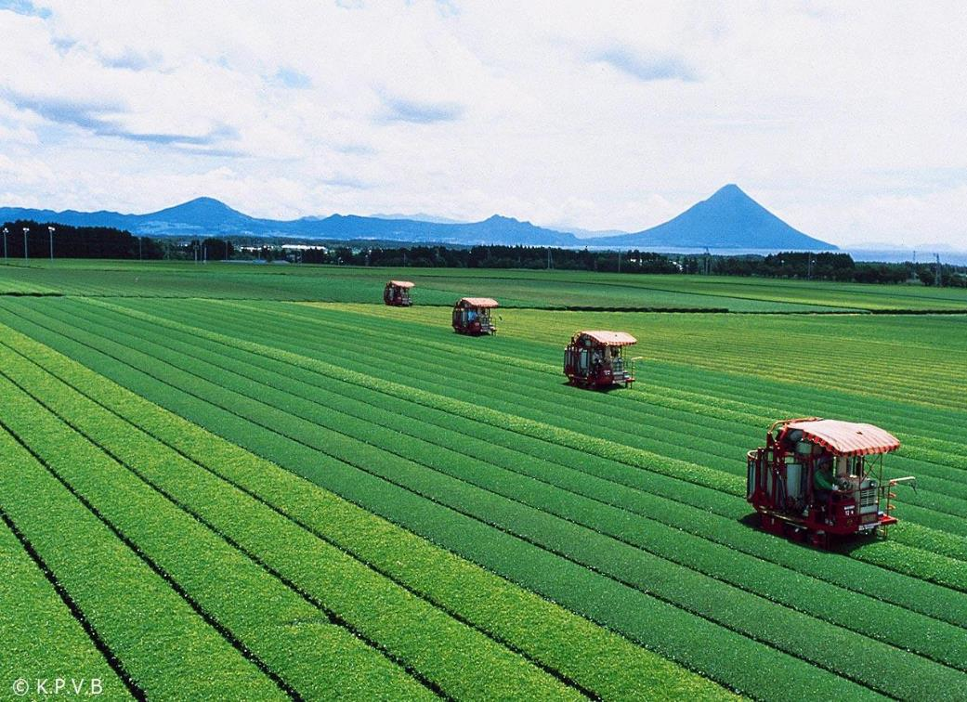
Thank you.
公司地址:臺北市南港區園區街3號15樓(南港軟體科學園區F棟)
代表號：+886-2-26557799(20線)
網址：www.ttch.com.tw

