Slide 1
Taiwan Tea Corporation
2020 Investor Conference

Slide 2
Disclaimer
In these presentations and discussions, there are certain forward looking statements regarding the results of operation, financial condition and current expectation abort future events. As forward-looking statements relate to events and depend on circumstances in the future, they involve risk and uncertainty.
We do not undertake any obligation to publicly revise or update any forward looking statements for availability of new information, future events or otherwise. Real result probably differ substantially from those expected in these forward-looking statements.

Slide 3
Agenda
Company Profile
Review of Operations
Business Highlight
Business Outlook
Q&A

Slide 4
Company Profile
Date of Establishment ：1950.6.15
Listed on TWSE：1962.2
Paid-in capital stock : NT $7.9 billion
Chairman：Ching-Yuan Wu
General manage ：Chin-Yen Lin
AgriCulture & Tea business
Recreational Business
Land Development
Nursery and cultivate of agricultural and tea products to produce a commodity for commercial and retail business.
Consolidate the agricultural business with the use of land assets to develop distinctive recreation and tourism markets.
Devising and implementation of the land assets for inventory management and vitalize integrated development feasibility.

Slide 5

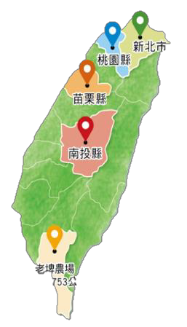









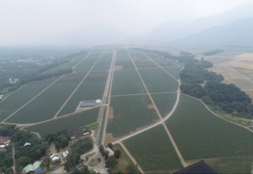
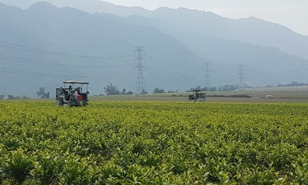
Company Profile-Tea garden/factory distribution
復興茶廠、大溪老茶廠
熊空茶廠、大寮茶文館
DAXI TEA FACTORY
XIONGKONG TEA GARDEN
Area: 3.4 ha
Cultivars : Green tea & black tea
Area: 5.4ha
Cultivars : Organic Green Tea, black tea and Oolong Tea
三義茶廠、銅鑼茶廠
魚池茶廠、日月老茶廠
SANYI、TONGLUO TEA FACTORY
ANTIQUE ASSAM TEA FARM
Area: 16 ha
Cultivars : Oriental Beauty Tea
Area:20.2 ha
Cultivars : TTES No. 8、No. 18、No. 21
精製廠、老埤農場
Laupi Tea Farm
鹿篙咖啡莊園
Area:717 ha
(Tea Garden Approx. 470ha)
Cultivars: TTES No. 8,No. 2,No. 17,No. 18, Chin-Shin Da Pan and Shi-Ji-Chun (Four Season)
LUGAO COFFEE GARDEN
Coffee Garden field: 12.7 ha
Local specialty : Sun Moon Lake Coffee

Slide 6
Review of Operations -Individual statements of comprehensive income
Unit:NT$Thousand | 1Q~3Q20 |  | 1Q~3Q19 |  | YoY | YoY(%)
Accounting Title | Amount | % | Amount | %
Operating revenue | 226,490 | 100% | 222,987 | 100% | 3,503 | 2%
Operating costs | (135,296) | -60% | (130,932) | -59% | (4,364) | 3%
Gross profit | 91,194 | 40% | 92,055 | 41% | (861) | -1%
Operating expenses | (199,266) | -88% | (220,847) | -99% | 21,581 | -10%
Net operating loss | (108,072) | -48% | (128,792) | -58% | 20,720 | -16%
Non-operating income and expenses | 731 | 1% | 99,714 | 45% | (98,983) | -99%
Income before income tax | (107,341) | -47% | (29,078) | -13% | (78,263) | 269%
Total tax income(expense) | 12,701 | 5% | 24,920 | 11% | (12,219) | -49%
Net income(loss) | (94,640) | -42% | (4,158) | -2% | (90,482) | 2176%
Other comprehensive income | (9,176) | -4% | (19,826) | -9% | 10,650 | -54%
Total comprehensive income for the period | (103,816) | -46% | (23,984) | -11% | (79,832) | 333%
Earnings per share(NTD) | (0.12) |  | (0.01) |  | (0.11) | 1100%

Slide 7
Review of Operations - Individual balance sheets
Unit:NT$Thousand |  | September 31,2020 |  |  | December 31,2019 |  |  | September 31,2019
Accounting Title |  | Amount | % |  | Amount | % |  | Amount | %
Current assets |  | 1,115,351 | 4% |  | 1,113,001 | 5% |  | 1,110,413 | 5%
Noncurrent assets |  | 23,789,593 | 96% |  | 23,482,733 | 95% |  | 23,441,936 | 95%
Total assets |  | 24,904,944 | 100% |  | 24,595,734 | 100% |  | 24,552,349 | 100%
Current liabilities |  | 1,021,940 | 4% |  | 618,539 | 3% |  | 755,455 | 2%
Noncurrent liabilities |  | 8,223,151 | 33% |  | 8,213,526 | 33% |  | 7,906,056 | 33%
Total liabilities |  | 9,245,091 | 37% |  | 8,832,065 | 36% |  | 8,661,511 | 35%
Total equity |  | 15,659,853 | 63% |  | 15,763,669 | 64% |  | 15,890,838 | 65%
Total liabilities and equity |  | 24,904,944 | 100% |  | 24,595,734 | 100% |  | 24,552,349 | 100%

Slide 8
Business Highlight- Tea Business
Laupi Tea Farm Progress
Progress at the end of 2019
20%
87%
Operating Machines construction
Tea Plantation
99%
10%
Tea Factory construction
Warehouse construction
100%
50%
99%
100%
Progress at the end of 2020

Slide 9
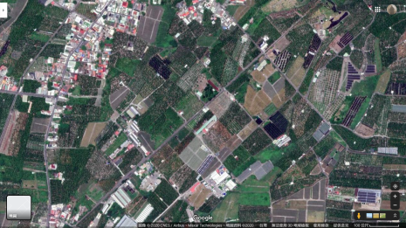
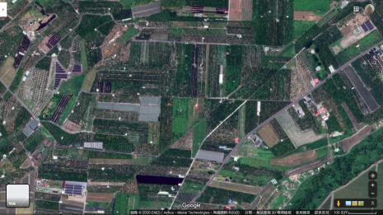
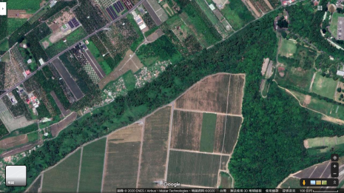
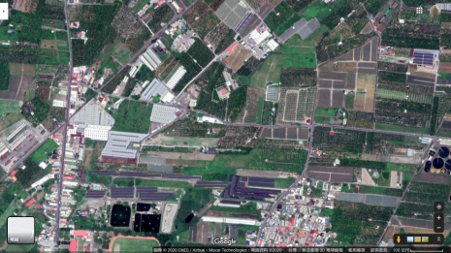
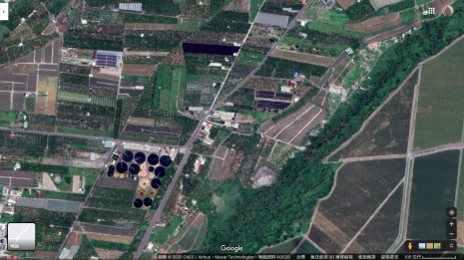
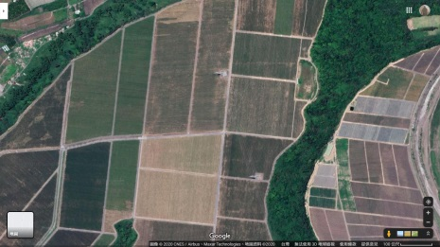
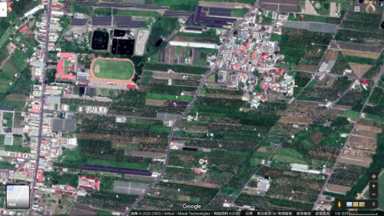
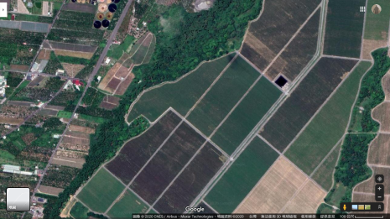
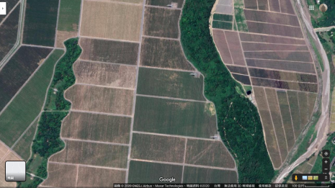
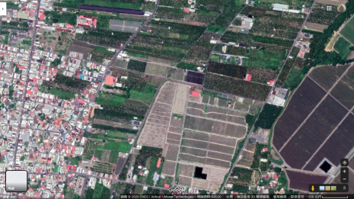
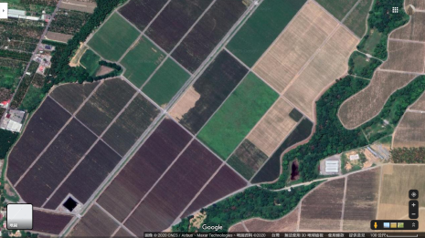
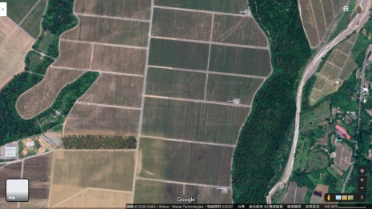
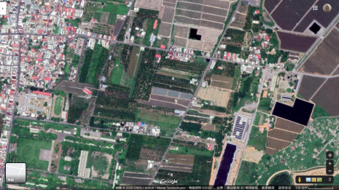
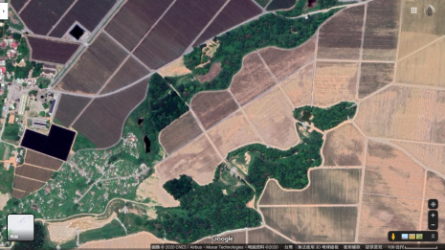
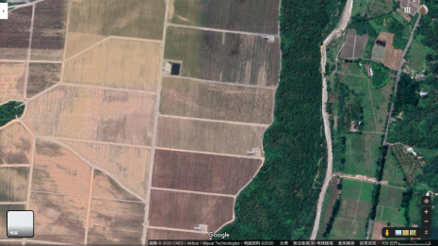
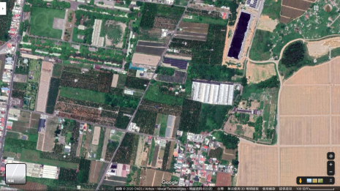
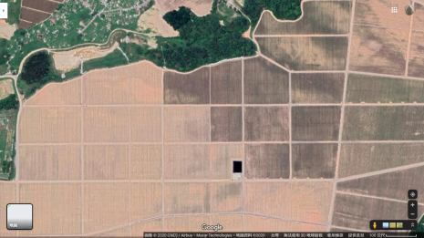
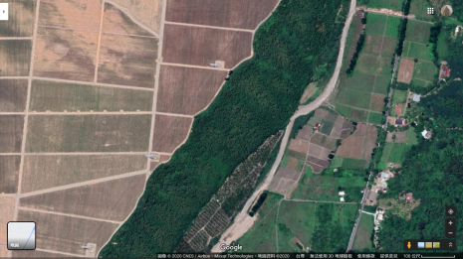
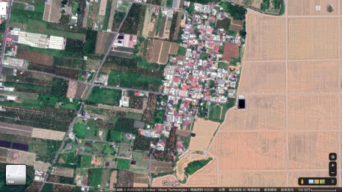
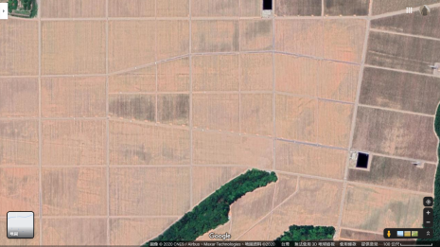
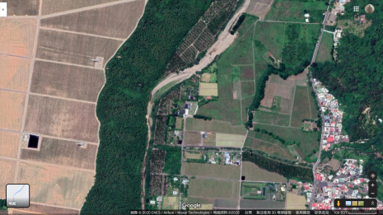
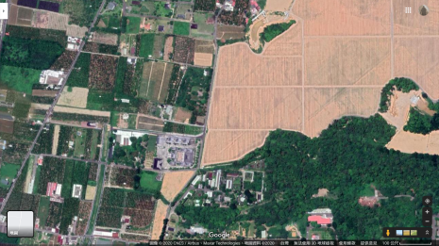
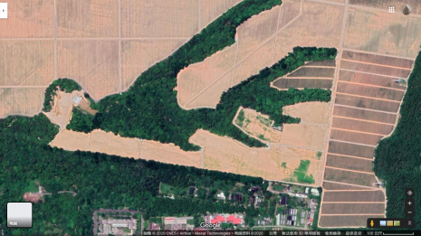
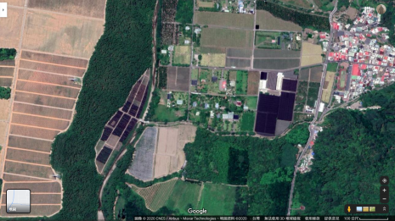
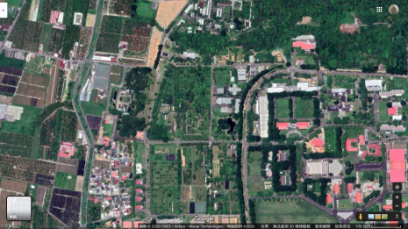
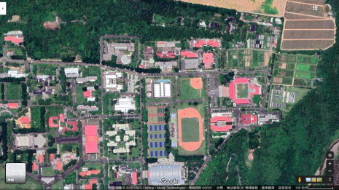
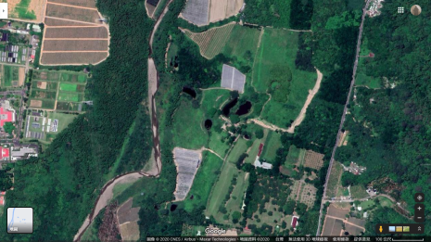
Business Highlight-Laupi Tea Farm
Tea Area [Phase 1]
(Cultivated area 110.59 hectares)
Tea Area [Phase 2]
(Cultivated area 125.33 hectares)
Pingdong Branch Office
Dormitory Phase II
Temporary Tea Factory
Tea Tree Nursery
Tea Factory
Warehouse
Tea Area [Phase 3]
(Cultivated area 87.9 hectares)
Tea Area [Phase 4]
(Cultivated area 129.18 hectares)
Laupi Tea Farm Area
The total planting area 453 hectares

Slide 10
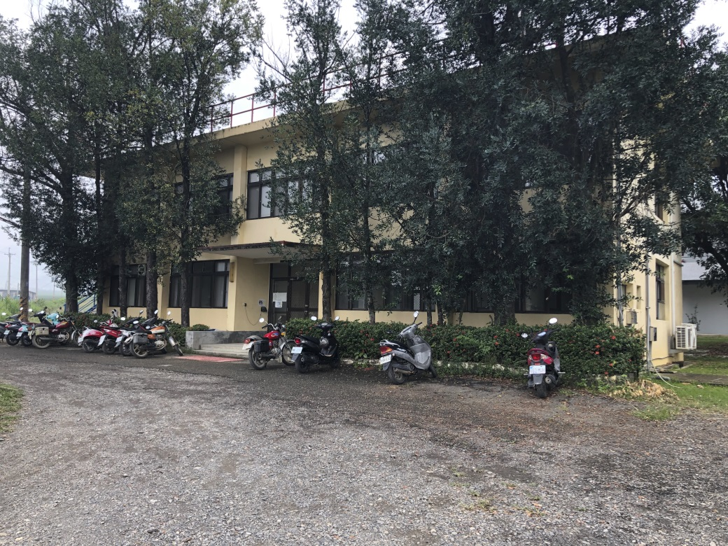
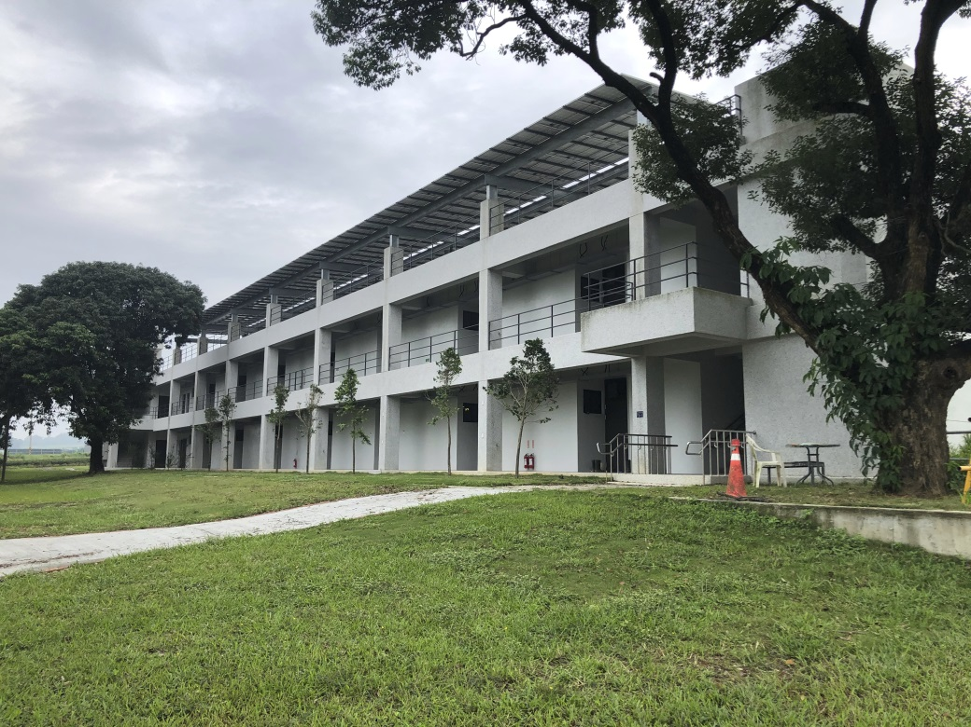
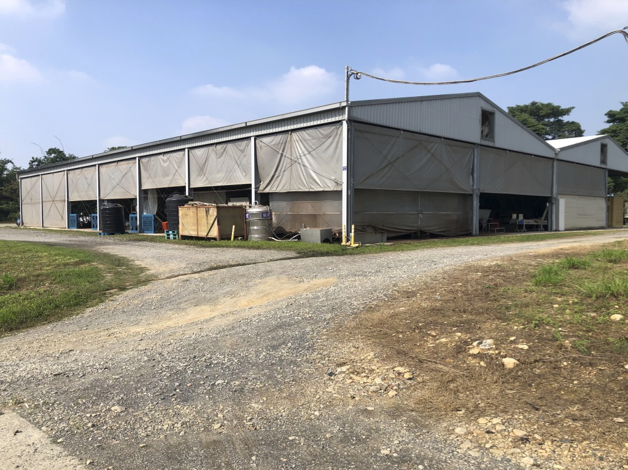
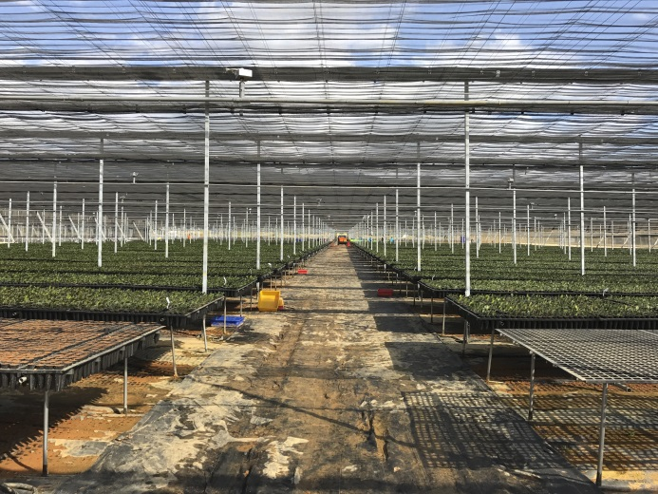
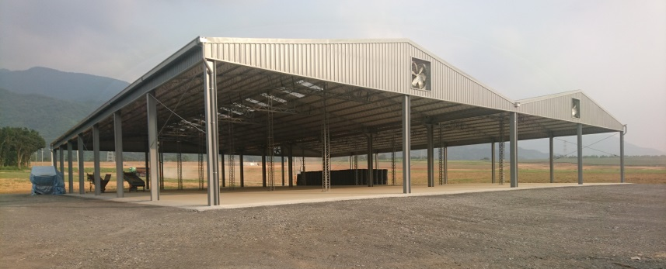
Pingdong Branch Office/Laupi Tea Farm
Laupi Tea Farm Dormitory Phase II
Laupi Temporary Tea Factory
Tea Tree Nursery

Slide 11
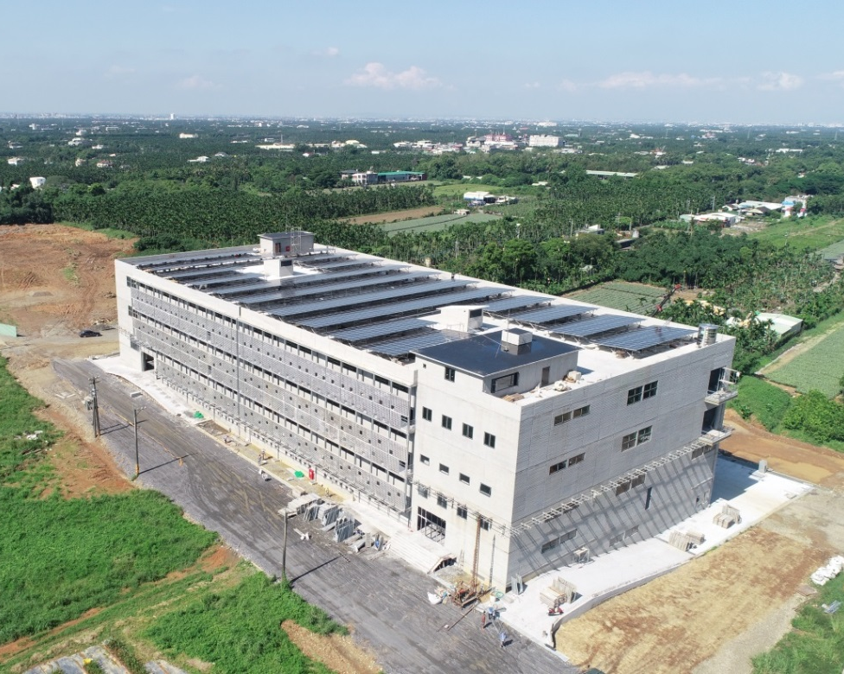
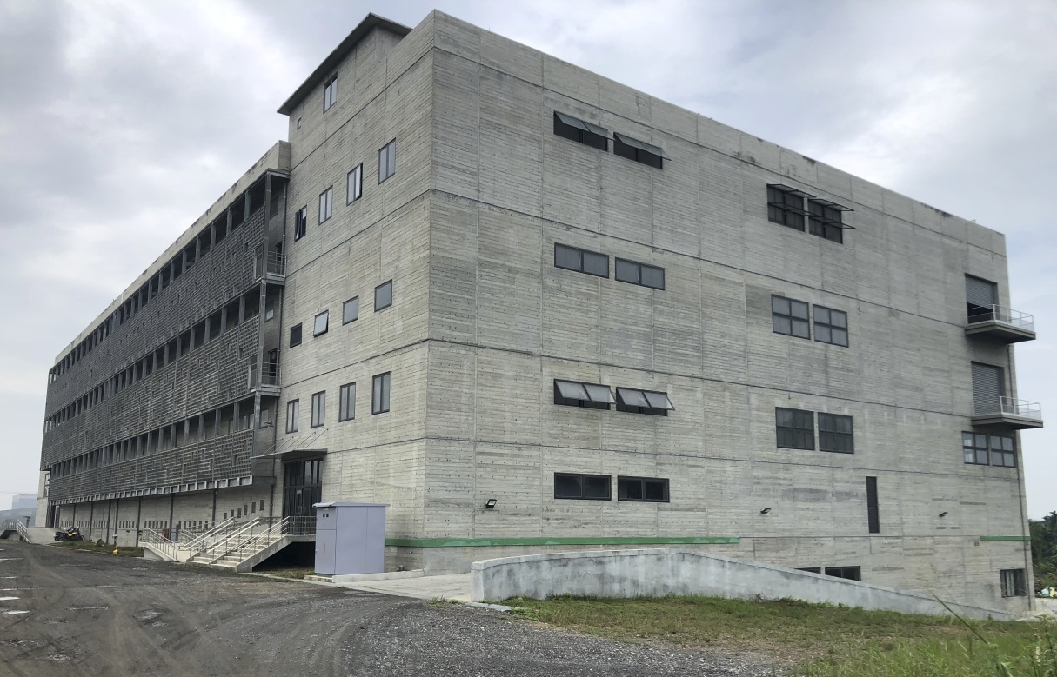
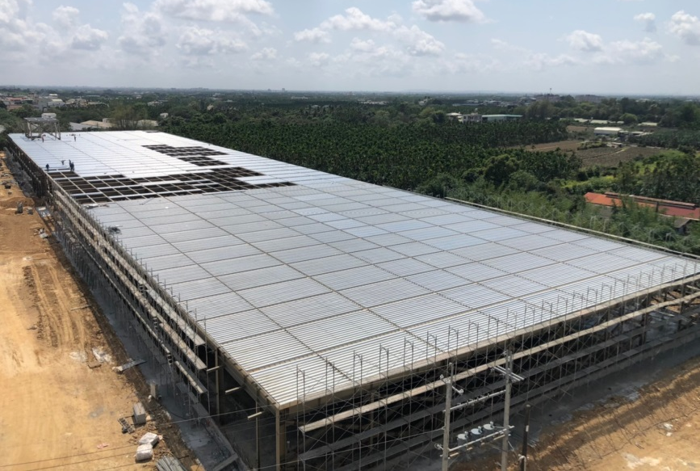
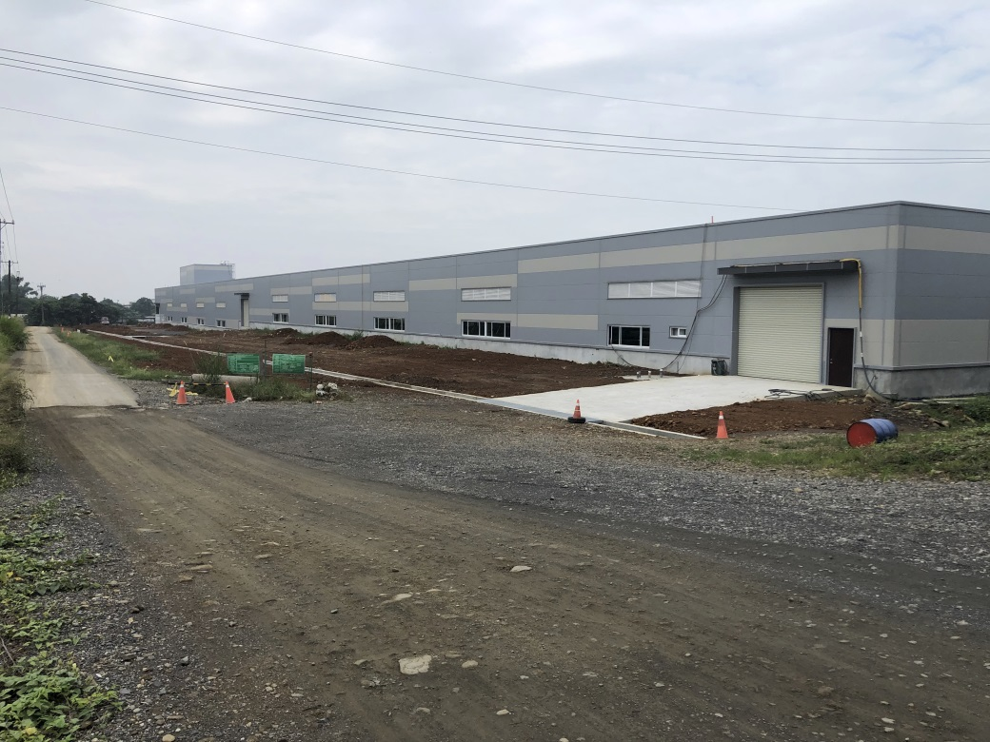
Laupi Tea Factory
Laupi Warehouse

Slide 12
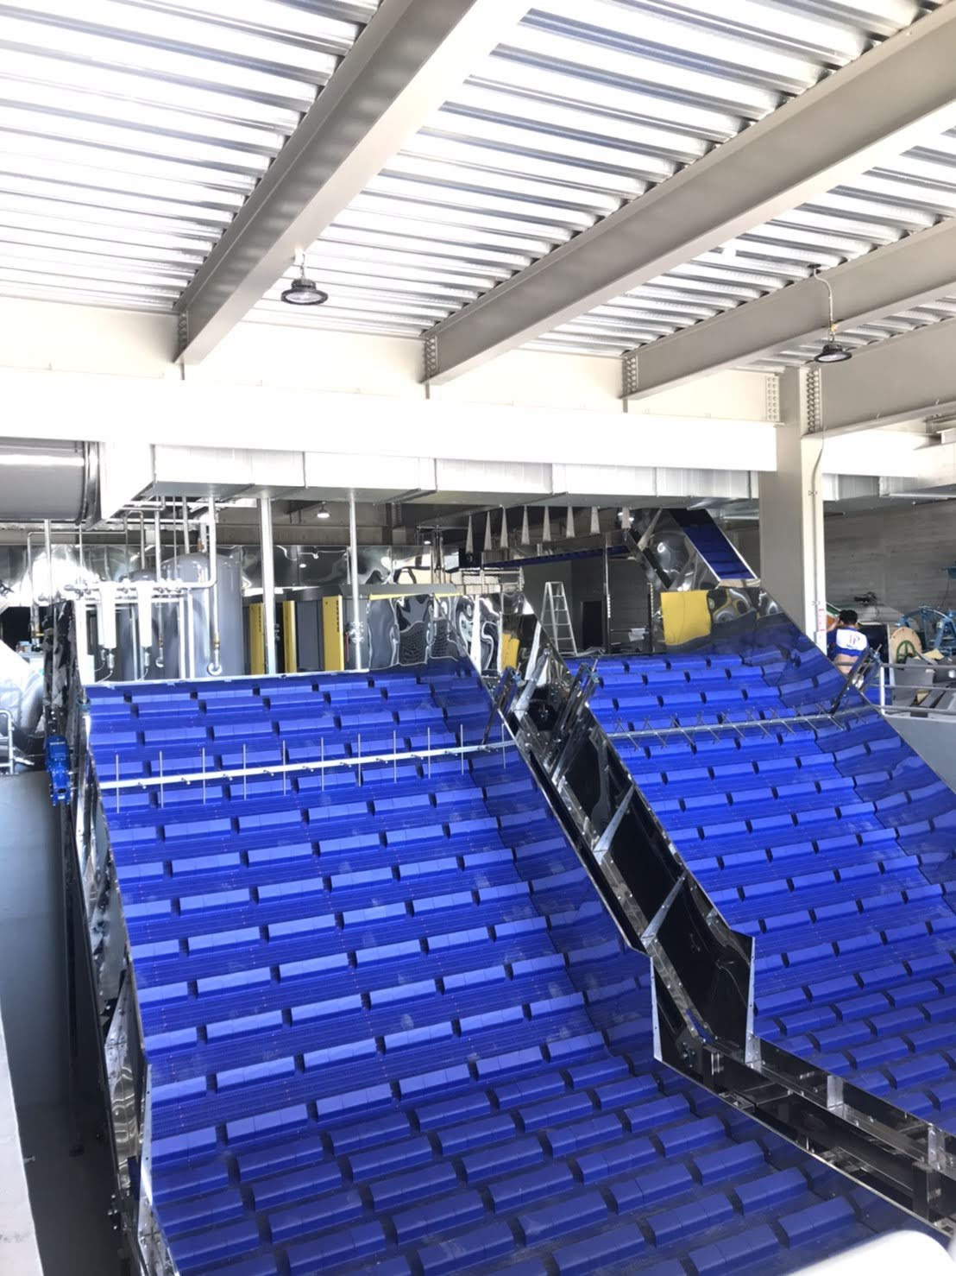
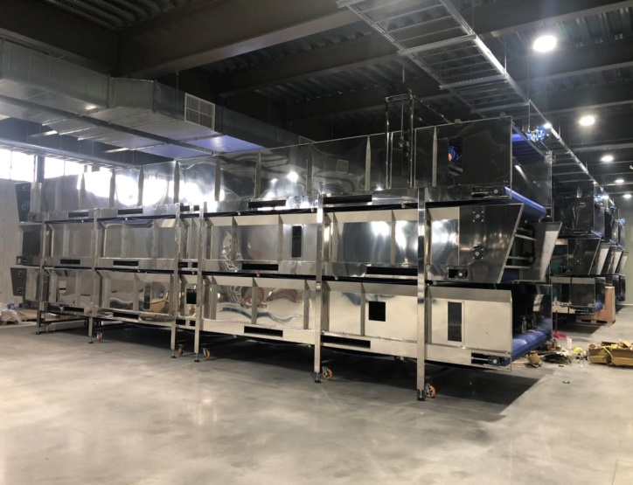
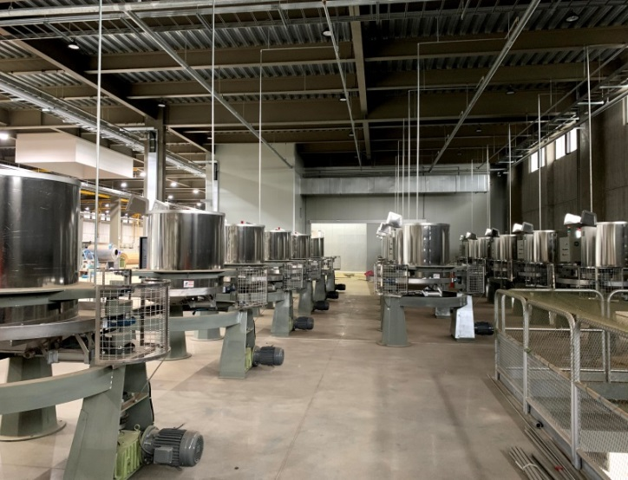
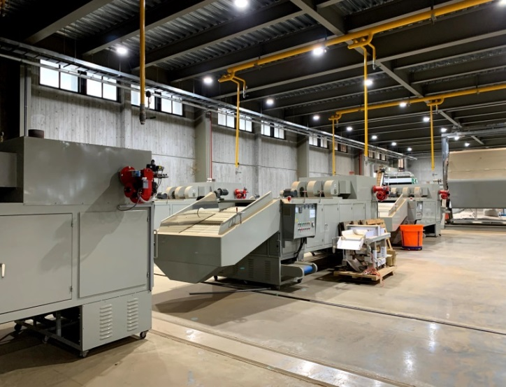
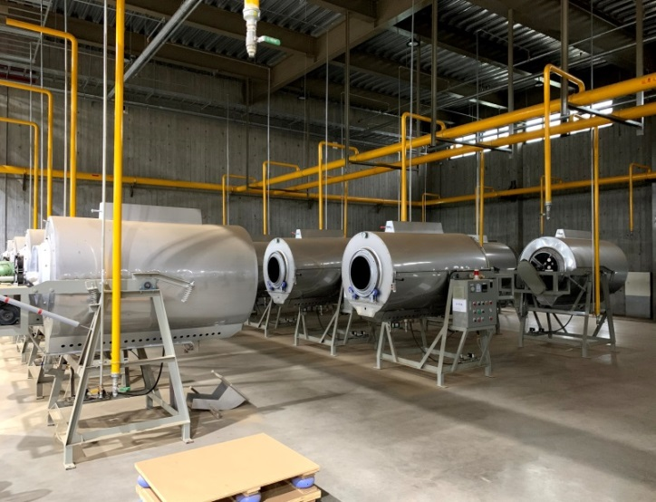
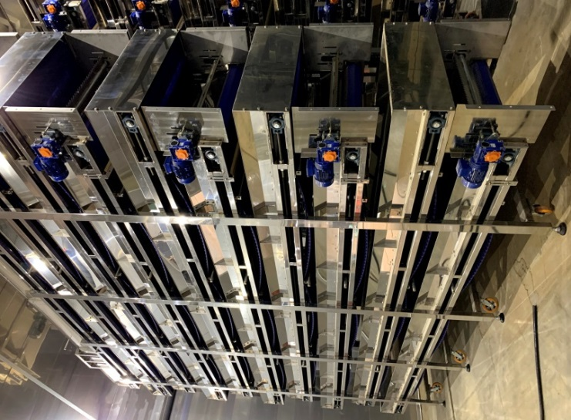
Tea factory layout of production line
Gathering Tea Leaves
Withering
Rolling
Drying
Frying
Fermenting

Slide 13
Business Highlight- Recreational Business
DAXI TEA FACTORY
Area:3.7 ha
TONGLUO TEA FACTORY
Area:30 ha
XIONGKONGTEA GARDEN Area:165 ha (Tea garden Approx 5.6 ha
DALIAO HISTORICAL HOUSE
Area:3 ha
ANTIQUE ASSAM TEA FARM
Area:21 ha
LUGAO COFFEE GARDEN
Area:5 ha (Tea garden Approx 2.5 ha
Recreation Operating revenue
 |  |  |  | Unit:NT$Thousand
 | 2020 Jan~Sep | 2019 Jan~Sep | YoY | YoY(%)
Xiongkong Tea Garden | 15,001 | 7,660 | 7,341 | 96%
Daliao Historical House | 2,275 | 2,050 | 225 | 11%
Daxi Tea Factory | 25,944 | 25,951 | (6) | 0%
Tongluo Tea Factory | 12,594 | 10,143 | 2,451 | 24%
Antique Tea Factory | 41,544 | 50,348 | (8,804) | -17%
Lugao Coffee Garden | 22,161 | 2,111 | 20,050 | 950%

Slide 14








Land Development [ Large land development cases ]
Commercial
Park
TTC Sanyi Industrial/Commercia Park
  •In2008, acquired development permission
  •In2010, completed water conservation and land preparation
  •In2010, completed revising land functional zone
Residential
Project
Miaoli Tongluo Residential Project
    •In2014, acquired development permission
  •In2019, completed water conservation and land preparation
  •In2019, completed revising land functional zone
Commercial Park
Exhibition Hall/Hotel
Miaoli Tongluo Industrial/Commercial Park
    •In2014, acquired development permission
  •In2019, completed water conservation and land preparation
  •In2019, completed revising land functional zone
Land Development
Increase asset value
Recreational
Park
Sun Moon Lake Recreational Project
    •In2015, acquired development permission •In2018, water conservation and land preparation
    plan permitted
    • Connecting road improvement required
Land asset vitalization is our main goal from 2007
Developed large land cases step into constructing and operating phases
Select potential land to develop in 2021
Development Projects
of Next Year
Profession consulting
Potential cases selection
Financial investment

Slide 15
Land Development [ Operating strategy ]
To increase asset value
- Land asset vitalization is our main goal
- Initiate promising development project in line with Land Act and related land policy
- Seek financial investment for the projects completed revising land functional zone
- Propose to draw developable land out of hillside restricted zone
To develop tea farm leisure industry
- Apply to establish new leisure farms in line with current business operation
- Apply for leisure farm operating permit to speed up farm transformation
- Organize the whole system of leisure business

Slide 16
Land Development [ Operating process ]
Completed Projects
  → Investment promotion
TTC Sanyi
Industrial / Commercial Park
Miaoli Tongluo
Industrial / Commercial Park
Miaoli Tongluo
Residential
Project
Land Development Cases
New Projects
  → Official review process
Miaoli Tongluo Industrial Park
Miaoli Tongluo Recreational Park
Reassess Project
  → After Land Act enforcement
Hillside zone revised
  → Zone plan proposed
Sun Moon Lake Recreational Project
Laupi Tea Farm
Hillside zone revised
New Leisure
Farm / Pasture
Xiongong second leisure farm
( camping area )
Daxi leisure farm
Shuitou farm
( pasture )
Farm
Transformation
Leisure Industry
Miaoli Tongluo leisure farm expansion
Turn Lugao coffee garden to
Lugao leisure farm
Leisure Farm
Registered
and Operated
Xiongong leisure farm
Shihmen leisure farm
Building License Permitted
Xiongong tea factory
Zhuwei agricultural facility

Slide 17
Prospect
Increase asset value
  Vitalize land development activation by generating more self-use、 lease or cooperation to enhance a profitable space.
  Interact with the govertment land development program to implement feasible planning solutions for land integration and reuse for the long-term potential value-added assets.
Reaching Performance goal
Strengthen technical capabilities
  Promoting the industrialization of the large-scale tea production system to Laupi Tea Farm and create an innovative tea-making industry chain respond to the robust demand for domestic beverage tea.
  Providing tea products with more safety, stable quality & quantities and price to expand the commercial tea market.
  The intensify implementation of the technological capabilities to scientific and technological farms to standardize the efficiency of modern tea factories and establish soft power that can replicate the large-scale economic model of the tea business.
Vision: To continuously promote the development of agriculture that takes into account of life, production and ecology with pursue corporate responsibility of social, economic, and environmental. TTC is committed to promoting smart agriculture through modernization digital technology enhances the value of traditional industries, strengthens tandem production and sales, establishes new model to creates vitality for agricultural development.

Slide 18
Q & A

Slide 19
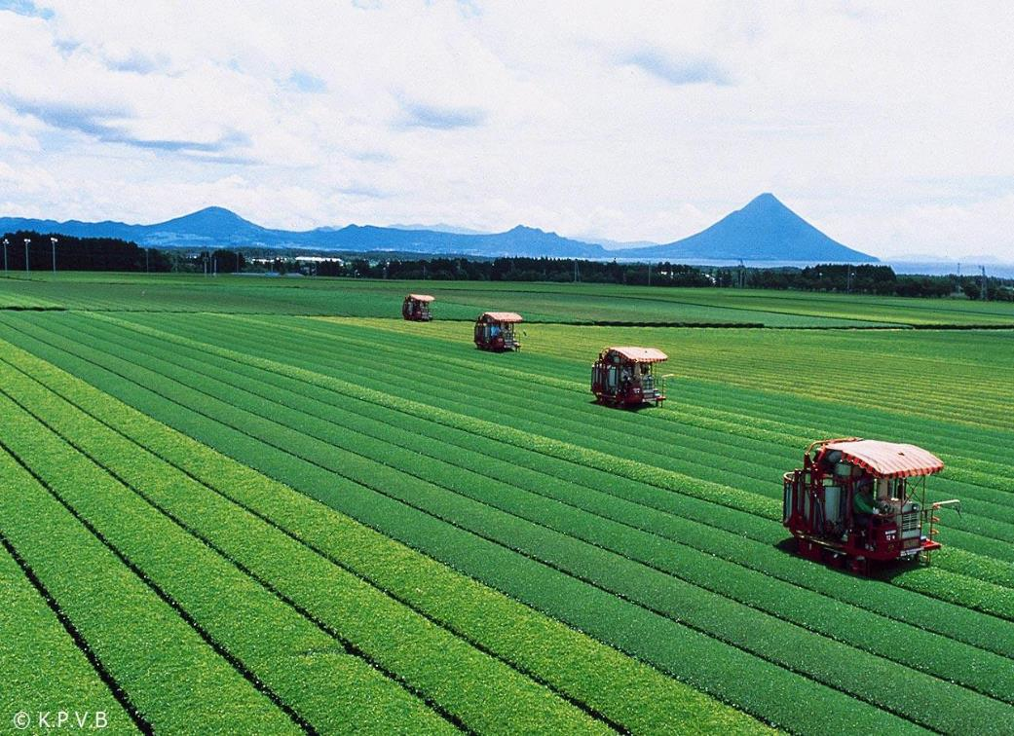
Thank you.
公司地址:臺北市南港區園區街3號15樓(南港軟體科學園區F棟)
代表號：+886-2-26557799(20線)
網址：www.ttch.com.tw

