Slide 1
Taiwan Tea Corp. 2024
QIC Taiwan CEO Week
October | Taipei

Slide 2

Disclaimer
The presentation and the relevant information mentioned in this material, including operating performance, financial performance, and the business outlook, have been compiled from both internal and external resources.
These forward-looking statements involve known and unknown risks, uncertainties, and other factors, including price variation, competition, global economy, exchange rate movement, and market demand, which may cause actual results to differ materially from those implied by such forward-looking statements.
This Presentation should not be considered as the giving of investment advice by the Company or any of its shareholders, directors, officers, agents, employees, or advisers. Each party to whom this Presentation is made available must make its own independent assessment of the Company after making such investigations and taking such advice as may be deemed necessary. In particular, any estimates or projections, or opinions contained herein necessarily involve significant elements of subjective judgment, analysis, and assumptions and each recipient should satisfy itself in relation to such matters.
The forward-looking statements expressed in this material reflect the Company’s current view about the future as of today. The Company is not responsible for any updates if there are any changes in the future.

Slide 3

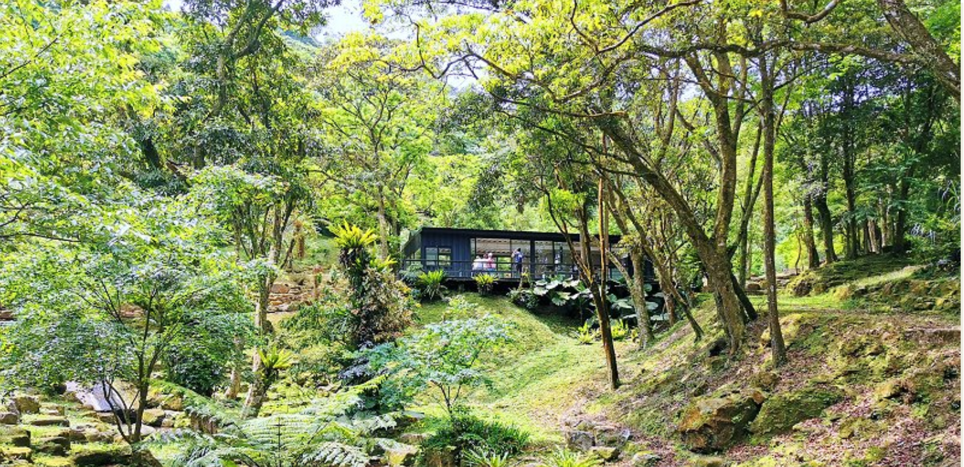
Executive Summary
Established in 1950, Taiwan Tea (2913 TT) is dedicated to four major business lines: 1) Tea cultivation, tea leaf, and tea product manufacturing, and marketing; 2) Agriculture tourism ; 3) Land asset operation outsourcing ; 4) Land development
TTC is the 2nd largest landowner in Taiwan with land assets of 3,714 ha, the current market value is NT$23.2 billion (2023/12/31). 2023 revenue was NT$ 380 million.
In 2019, Mr. Wu, Ching-yuan was elected as the Chairman of Taiwan Tea. He initiated a series of margin improvement plans to turn TTC profitable.
Taiwan Tea also leverages its tea garden and tea culture to develop a tourism business. At the same time, the management team actively reviews its own land assets for further development and collaboration, to create sustainable revenue and profit.

Slide 4
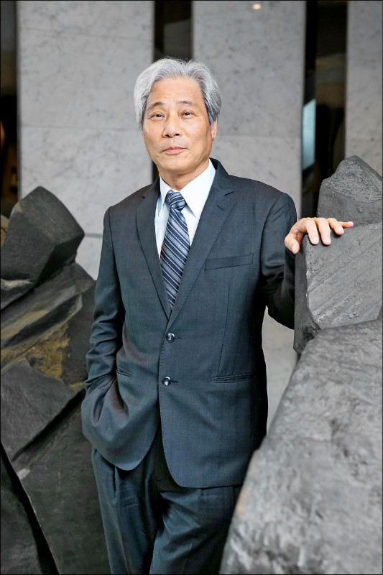

Strong Leadership-
Chairman: Wu, Ching-Yuan
Chairman Wu graduated from the National Taipei University of Technology and holds an associate degree in Mechanical engineering, he also holds a Master’s Degree in architecture and urban Planning from Chung Hua University.
Mr. Wu was elected to be the Chairman in 2019 and was re-elected in 2022. He is now promoting corporate transformation and margin improvement.
Chairman Wu spent 9 years to reform Sanyang Motor and led the company to achieve record high revenue and margin. Meanwhile, Chairman Wu will keep introducing the successful experience of Sanyang Motor and make TTC profitable in the shortest time.
Under his leadership, Taiwan Tea’s 2023 revenue grew 27% versus 2019 and the revenue has grown five years in a row.

Slide 5
TTC’s Way to Success
Core Business
Margin Improvement
Land Assets
Tourism
Maintain and strengthen TTC’s leading position in the tea market in Taiwan.
Taiwan Tea’s tea leaf production reaches 500 tons until 2025 , accounting for 3% of the total production of Taiwan.
Leveraging tea plantations and land in the beautiful mountainous areas with great potential for tourism and leisure and become a solid second revenue and profit stream.
Under the new management team’s observation and operation, to achieve the goal of sustainability and margin improvement, TTC will reform part of its tea and recreational business.
The land capital of Taiwan Tea should be utilized properly. With continuous revitalization and reinvestment, TTC maximizes the value of the land.

Slide 6
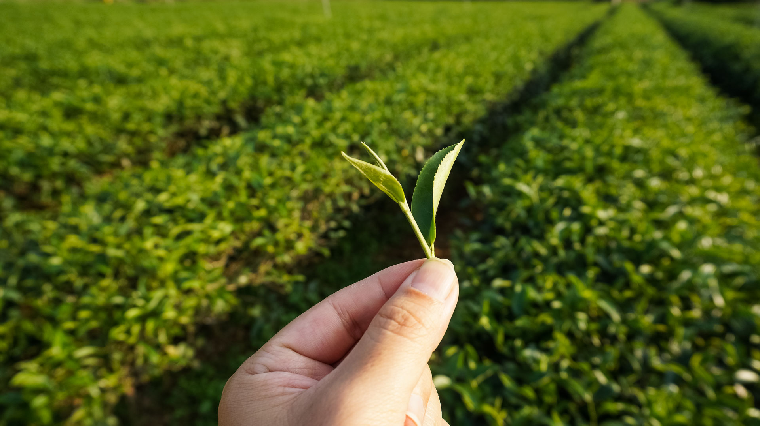
Tea Production
Photo Credit: https://ezgo.coa.gov.tw/zh-TW/Front/News/Detail/1279

Slide 7



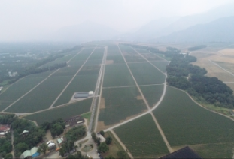
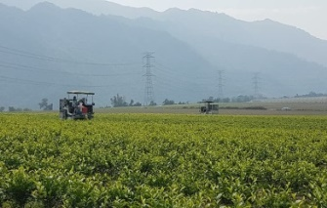
Tea Garden & Factories
三義茶廠
SANYI TEA FACTORY
熊空茶廠
XIONGKONG TEA GARDEN
Cultivars: Oriental Beauty Tea
Cultivars: Organic Green Tea, black tea
老埤農場
LAUPI TEA FARM
魚池茶廠
ANTIQUE ASSAM TEA FARM
Area:717 ha
Cultivars: TTES No. 8,No. 12,No. 17,No. 18, No. 20 Chin-Shin Da Pan and Shi-Ji-Chun (Four Season)
Cultivars : TTES No. 8、No. 18、No. 21、coffee

Slide 8
First Smart Tea Garden in Taiwan
Micro-Weather Management
Precision Irrigation
Big Data Management
Organic and High Quality
Applying precision irrigation technology developed by Netafim. With 14,000 drip holes per hectare covering over 94% of the planting area, we managed to save 70% of irrigation water and 50% of fertilizer.
We applied 3 platforms to collect big data:
Smart Agri-management Platform(SAMP) for product traceability
Dispatching App to monitor the productivity of each production unit
Plant doctor App to monitor the entire process of cultivation.
We started our organic plantation in 2003. TTC pledged to produce our tea leaves at the highest safety and highest quality standards. We also use biodegradable bioplastic for our product packaging.
We set up 6 micro-weather stations and soil moisture sensors to monitor the parameters of plant growth, and to analyze the best conditions for cultivation.

Slide 9
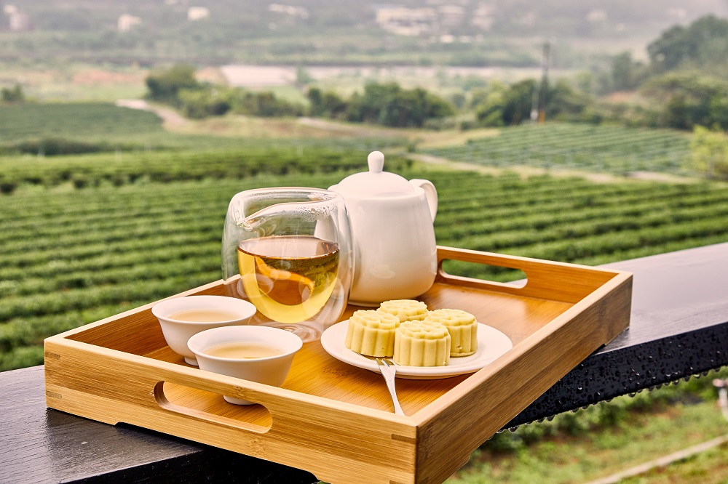
Recreational Business

Slide 10
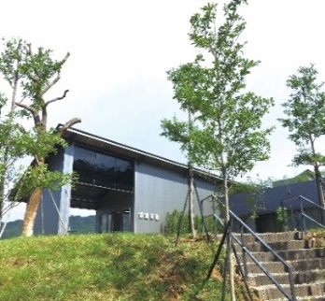
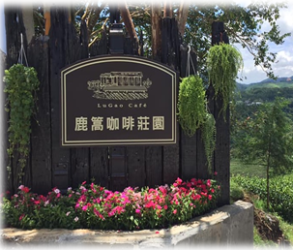
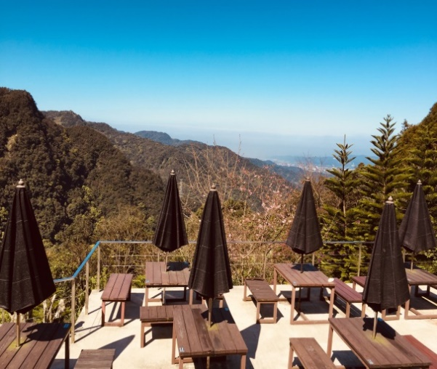
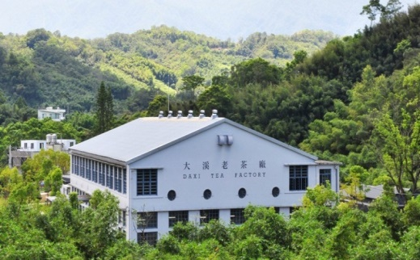
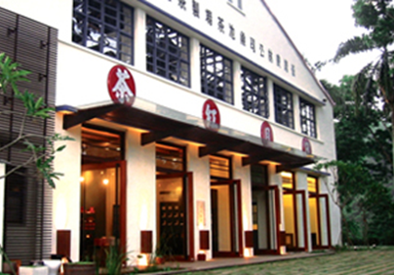
Recreational Business Highlights
Xiongkong Leisure Farm
(Operated by He Xu International since 2023/1/1)
TONGLUO TEA FACTORY
LUGAO COFFEE GARDEN
DAXI TEA FACTORY
ANTIQUE ASSAM TEA FARM
165 ha
(Tea garden 5.6 ha)
15.9 ha
7.5 ha
9.8 ha
3.7 ha
Notes:
銘栗:建議刪熊空，因為已委外出租

Slide 11
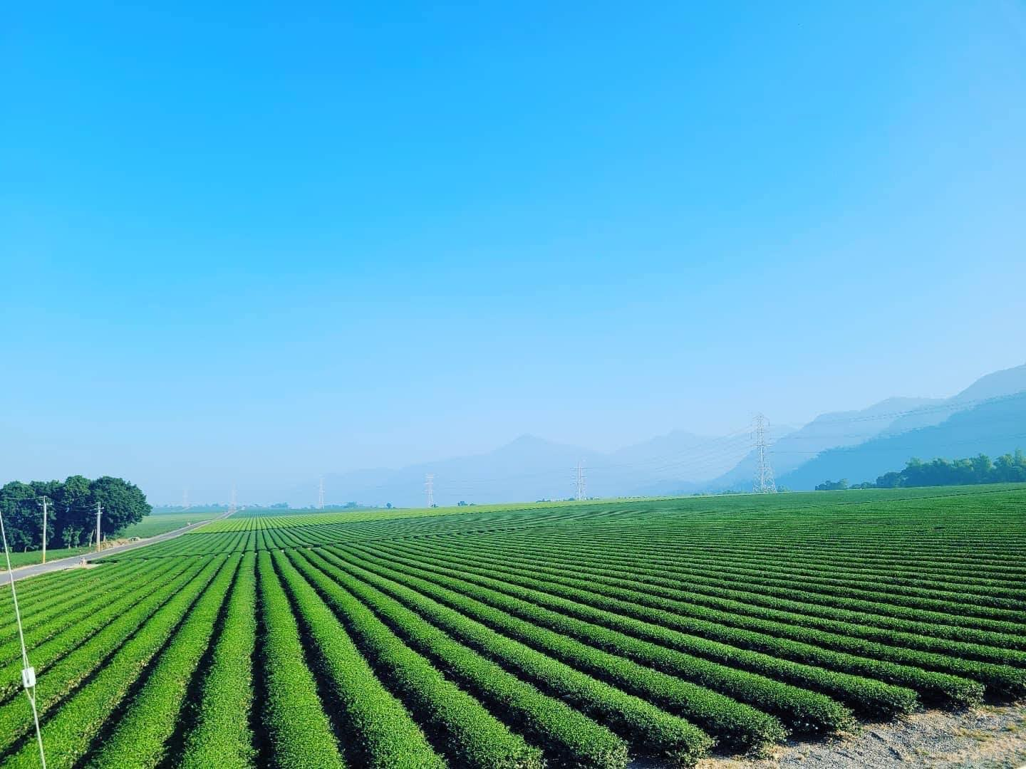
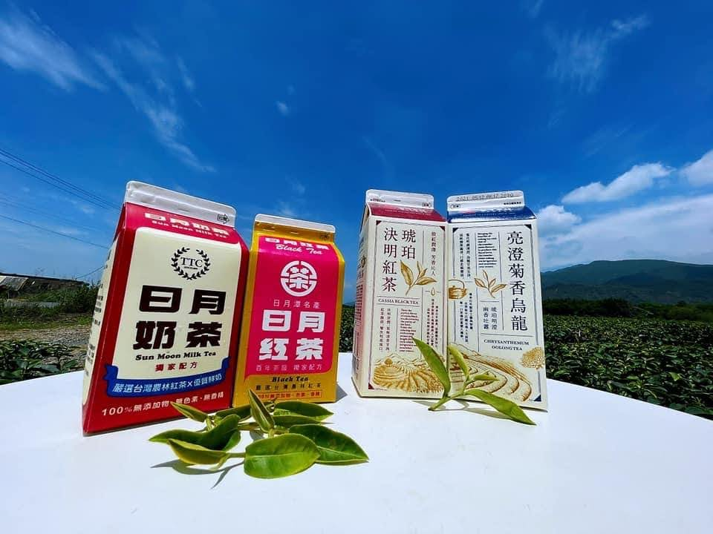
Margin Improvement

Slide 12
Margin Improvement
NT $ mn | 2018 | 2019 | 2020 | 2021 | 2022 | 2023 | 1H24
Revenue | 254 | 299 | 312 | 369 | 377 | 380 | 192
Gross Profit | 116 | 121 | 125 | 118 | 165 | 138 | 69
Operating Profit | -173 | -169 | -148 | -182 | -155 | -125 | -48
Since the high operating costs of Taiwan Tea's tea cultivation and recreational tourism business are unfavorable to the company’s profit, Chairman Wu has decided to adopt different strategies and make Taiwan Tea profitable in a short period of time, turning it into a sustainable enterprise.
  Planning to moderately reduce the area dedicated to tea cultivation and halt capacity expansion. It will release over 200 hectares of land in Pingtung for future diversified development, aiming to maximize efficiency.
  TTC has outsourced part of its recreational tourism business, resulting in lower OPEX and higher efficiency.
The two plans above will be implemented in the next three to five years.
Notes:
2017年主要有竹南土地存貨出售，故營收及利益高達22億及3.8億
2021年老埤製茶⼯廠建設完成，相關利用率較低，連帶使毛利率由2020年的40%下降到2021年的32%，連帶營業虧損由2020年的1.48E增加到2021年的1.82E
2022年將毛利率較低工程部門減少接單，同時受惠茶葉訂單增加，使毛利率由2021年的32%上升到2022年44%，連帶營業虧損由2021年的1.82E減少到2022年的1.55E
2023年受惠於2022年底將營運總部由南港遷至湖口，營業費用大幅減少，連帶使營業虧損由2022年的1.55E減少到2023年的1.25E

Slide 13
Land Development

Slide 14








Land Development - Selected Cases
Commercial Park
Industrial Park
Residential Project
Shopping Mall/ Hotel
Development Process
TTC Sanyi Industrial/
Commercial Park
    In 2022, acquired feasibility planning approval
    In 2023, acquired project development approval
    In 2023, acquired approval of the Environmental Impact Assessment Committee
    In 2024, the soil and water conservation plan approved.
    In 2024, completed revising the land functional zone
Northern Miaoli Tongluo Industrial Park
    In 2021, acquired feasibility planning approval
    In 2024, reviewed by the project development committee
    In 2024, reviewed by the Environmental Impact Assessment Team
Miaoli Tongluo Residential Project
    In 2014, acquired development permission
    In 2019, completed water conservation and land preparation
    In 2019, completed revising the land functional zone
Miaoli Tongluo Industrial / Commercial Park
    In 2014, acquired development permission
    In 2019, completed water conservation and land preparation
    In 2019, completed revising the land functional zone
Professional Consulting
Potential Cases Selection
Financial Investment
Revitalize its land assets and enhance the overall value.
Initiate promising development projects in accordance with the government’s land policy.
For large-scale development projects with completed land-use changes, we are actively seeking investment and partnership opportunities.
Land Development
Increase asset value

Slide 15
Land Development Strategy
Land Development Projects
To Increase Asset Value
Revitalize land assets and evaluate the potential profit of each project
Initiate promising development projects in accordance with the government’s land policy
For large-scale development projects with completed land-use changes, we are actively seeking investment and partnership opportunities.
Completed Projects
Investment Promotion
New Projects
Target to Get Official Approval
Northern Miaoli Tongluo
Residential Project
Northern Miaoli Tongluo
Industrial / Commercial Park
TTC Sanyi Industrial/
Commercial Park
Seeking Business Partners
Northern Miaoli Tongluo
Industrial Park
Seeking Business Partners
Building under Design
Seeking Business Partners
Building under Design
Development Plan under Review
Environmental Impact Assessment under Review

Slide 16
Recreational Business Strategy
Develop Recreational Business
Recreational Business
Develop and expand the tea tourism business
Transform existing agricultural facilities into tourist farm
Build up well-organized agriculture tourism business
Currently under Operation
Filing for Business
Registration for Tourist Farm
Transform existing facilities
Keep focusing on the reformation
of existing tea/ agricultural facilities
Nantou, Yuchi
Lugao Coffee Garden
New Taipei, Sanxia
Xiongkong
Tourist Farm
Miaoli, Tongluo
Jiuhu
Tourist Farm
Under Planning and Preparation
Collaborative operations are currently under organization
Currently Under Operation
Taoyuan,Daxi
Shimen Tourist Farm
Collaborative operations are currently under organization

Slide 17


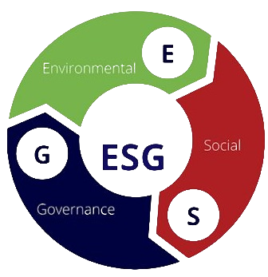



台灣農林 ESG
TTC

Slide 18



ESG: Resource Protection & Reduction
6 micro weather stations
70% reduction in water usage
50% reduction in fertilizer usage
Water storage facilities to reduce groundwater extraction during drought conditions
475 hectares of afforestation
Protection of old-growth forest
20+ endemic animals sighted on company properties
Intelligent Irrigation
Forest Conservation
538 kW of rooftop solar
688 MWh of electricity production annually
NT$180k per annum electricity reduction by LED light replacements
High-efficiency gas boiler upgrade
Since 2014, most tea bags, threads, and labels are made from biodegradable materials at a higher cost
Energy Efficiency
Biodegradable Packaging

Slide 19

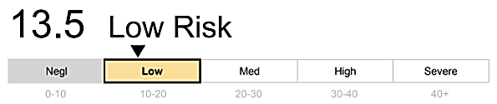


Global Recognition on ESG Performance
Sustainalytics Score
International Certification
Quality Assurance
13.5 Sustainalytics score
Ranked 2nd out of 181 in industry by Sustainalytics
ISO22000 & HACCP International food safety certification
Requires TQF, HACCP, ISO, BRC, and FSC certification from the supplier
Passed 473 pesticide residue inspection
Certified organic products
97.5% of products passed SGS inspection
Diversity & Equality
Sustainability Funds
53% male, 47% female workforce
1:1.2 female-to-male pay ratio at the supervisor level
1:1.02 female to male pay ratio at non-supervisor level
Inclusion in DFA Emerging Markets Social Core Equity Portfolio
Inclusion in DFA Emerging Markets Sustainability Core 1 Portfolio

Slide 20


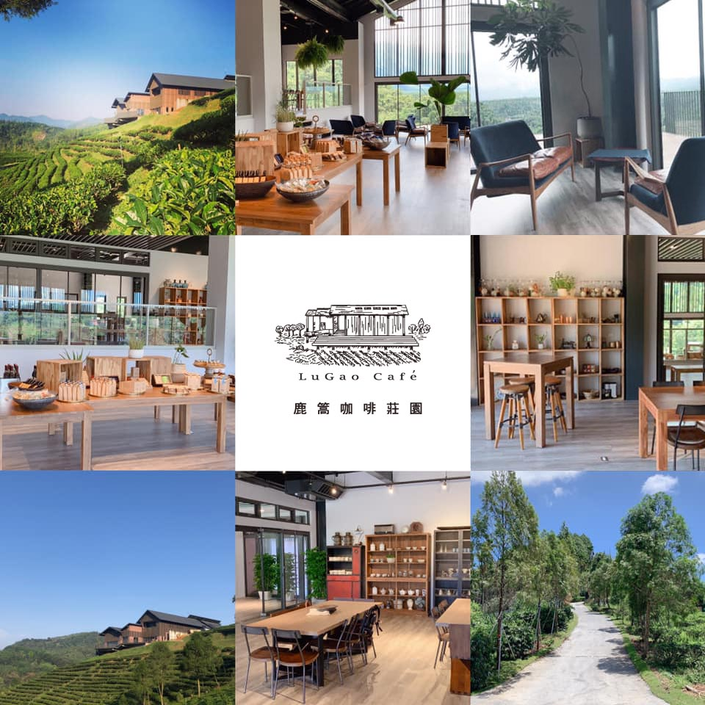
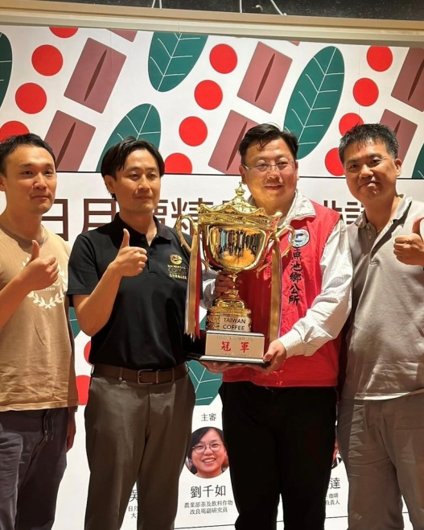
Lugao Coffee Garden has Won the Sustainable Estate Award
2024 Sustainable Coffee Estate Competition, amid fierce competition among coffee producers across Taiwan, evaluated each estate on environmental, economic, and social sustainability. The top 10 exemplary sustainable coffee estates in Taiwan were selected and awarded the "Sustainable Estate Award."
The top ten estates awarded the "Sustainable Estate Award" will receive further support from the Rural Development, Soil and Water Conservation Agency of the Ministry of Agriculture to participate in promotional activities at the SCAJ International Coffee Exhibition in Tokyo, Japan. By showcasing the achievements of sustainable coffee estates, the goal is to enhance the international visibility of Taiwan’s premium domestic coffee in global markets.

Slide 21
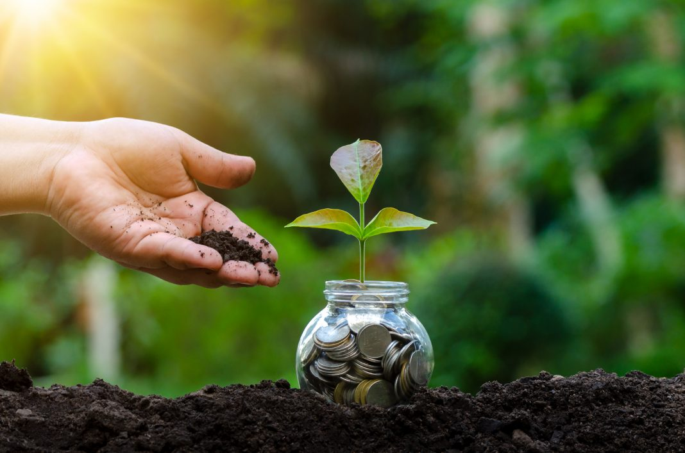
Financials

Slide 22
5-Year Income Statement
NT$ Million | 2020 | 2021 | 2022 | 2023 | 1H24 |  | YoY (%)
 |  |  |  |  |  |  | 2020 | 2021 | 2022 | 2023 | 1H24
Sales Revenue | 312 | 369 | 377 | 380 | 192 |  | 4 | 18 | 2 | 0.8 | 2.3
Gross Profit | 125 | 118 | 165 | 138 | 69 |  | 3 | (6) | 40 | (16) | 9.2
Operating Profit | -148 | -182 | -155 | -125 | -48 |  | (12) | 23 | (15) | (19) | (31)
Income Before Tax | -33 | -1,135 | -1,614 | -292 | -96 |  | (81) | 3,339 | 42 | (82) | (17)
Net Income to Parent | -17 | -1,122 | -1,635 | -287 | -96 |  | (88) | 6,500 | 46 | (82) | (18)
EPS(NT$) | -0.02 | -1.42 | -2.07 | -0.36 | -0.12 |  | (89) | 7,000 | 46 | (82) | (20)
Key Financial Ratio (%)
Gross Margin | 40.0 | 32 | 44 | 36 | 36
Operating Margin | (47.3) | (50) | (41) | (33) | (25)
OPEX Ratio | 87.3 | 82 | 85 | 69 | 61
Net Margin | (5.6) | (304) | (434) | (76) | (50)
22

Slide 23
5-Year Balance Sheet
NT$ Million | 2020 | 2021 | 2022 | 2023 | 1H24 | YoY (%)
 |  |  |  |  |  | 2020 | 2021 | 2022 | 2023 | 1H24
TOTAL ASSETS | 25,098 | 24,249 | 21,850 | 21,580 | 21,606 | 2.0 | (3.4) | (9.9) | (1.2) | (0.5)
Cash | 176 | 215 | 239 | 151 | 90 | 40.5 | 22.2 | 11.1 | (36.8) | (43.6)
NR & AR | 18 | 38 | 33 | 34 | 141 | (5.5) | 111.1 | (13.1) | 3 | 348.3
Inventory | 895 | 902 | 946 | 964 | 1,030 | 1.2 | 0.8 | 4.8 | 1.9 | 8.7
Fixed Assets | 6,504 | 6,693 | 6,250 | 6,226 | 6,164 | 6.8 | 2.9 | (6.6) | (0.4) | (1.4)
TOTAL LIABILITES | 9,306 | 9,572 | 8,864 | 8,875 | 8,997 | 5.4 | 2.9 | (7.4) | 0.1 | 1.6
Bank Loans | 5,923 | 6,253 | 5,549 | 5,188 | 5,234 | 9.8 | 5.6 | (11.3) | (6.5) | 1.5
NP & AP | 16 | 37 | 14 | 13 | 9 | 19.6 | 131.3 | (62) | (7.1) | 28.1
TOTAL EQUITY | 15,792 | 14,678 | 12,986 | 12,705 | 12,609 | 0.2 | 7.1 | (11.5) | (2.2) | (2.0)
A/R days | 21.1 | 26.7 | 33.5 | 32 | 83
Inventory days | 1,736.3 | 1,304 | 1,659 | 1,460 | 1,460
A/P days | 28.3 | 38.0 | 43.5 | 20 | 22
ROE(%) | (0.1) | (7.4) | (11.8) | (2.2) | (0.8)
ROA(%) | (0.1) | (4.3) | (6.7) | (0.8) | (0.2)

Slide 24


Slide 25
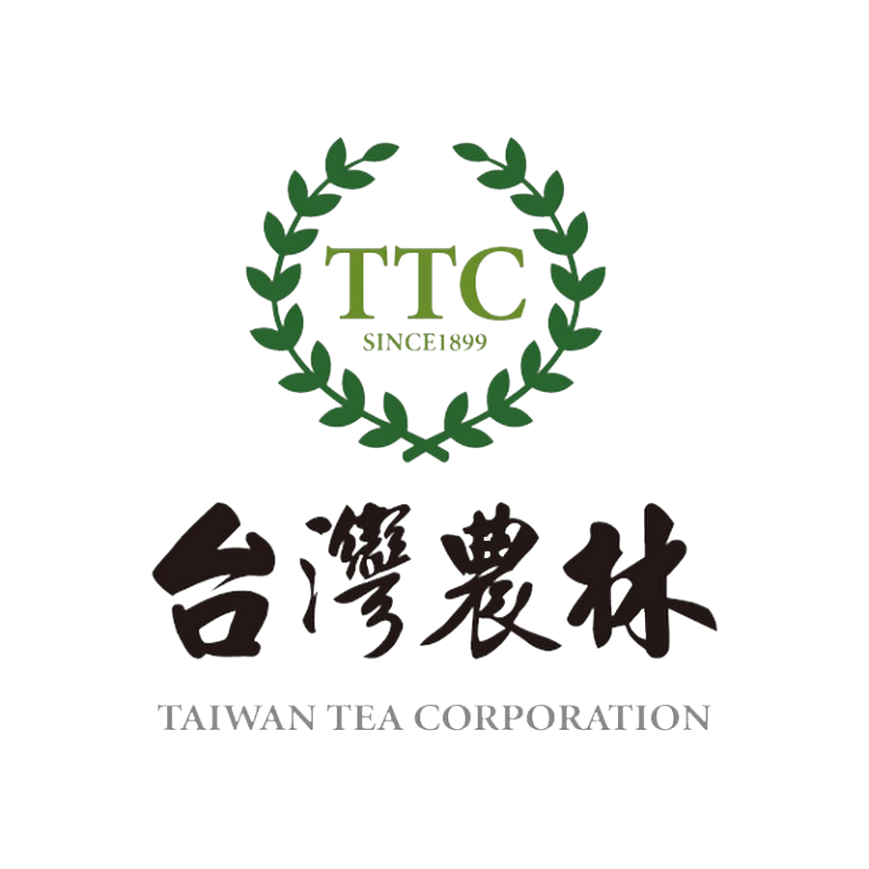
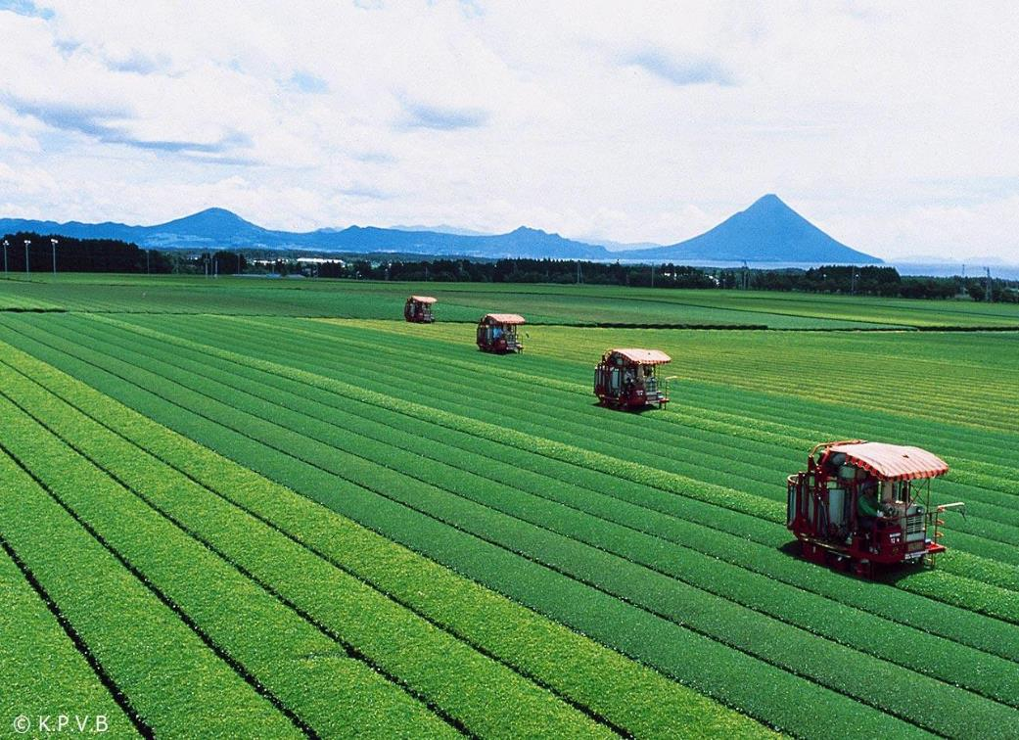
No. 3, Zhonghua Rd., Hukou Township, Hsinchu County , Taiwan (R.O.C.)
+886-3-6591188
www.ttch.com.tw
THANK YOU

